Slide 1

DESIGN PRACTICUM
Development of lab scale flume for studying dynamics of debris flow
Group - 34

Slide 2

Group Members
B 22226 Om Litoriya
B 22122 Lohit Vardhan
B 22029 Aditya Kumar
B 22306 Mayank Goel
B 22112 Kumbha Sravya
B 22316 Ritik Kumar
Faculty Mentor :
Dr. Mousumi Mukherjee
Assistant Professor
School of Civil and Environmental Engineering
Dr. K. V. Uday
Associate Professor
School of Civil and Environmental Engineering

Slide 3
Contents
Introduction And Motivation
Methodology
Setup
Result
Future Aspects
Conclusion

Slide 4
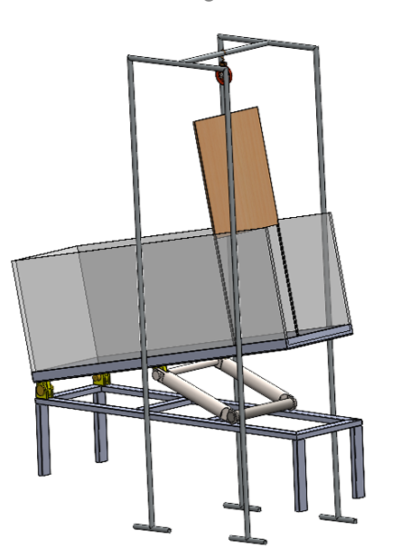
Introduction
Understanding and managing debris flows through laboratory flume studies.
Utilizing a mini flume to analyze flow dynamics and develop mitigation strategies.
Aim to contribute to effective mitigation strategies for debris flows, especially with the increasing risk posed by climate change.
Flume setup

Slide 5
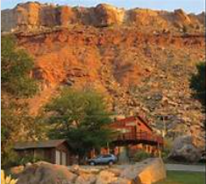
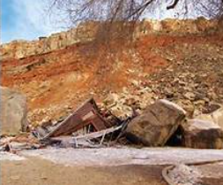
Motivation
Lab-scale experiments allow researchers to simulate changing climate conditions .
This experiment will allow us to study about the dynamics of landslides and to avoid their destructiveness as shown below in Fig. 1 and Fig. 2
before
after
www.slideserve.com
www.google.com
Fig-1
Fig-2

Slide 6

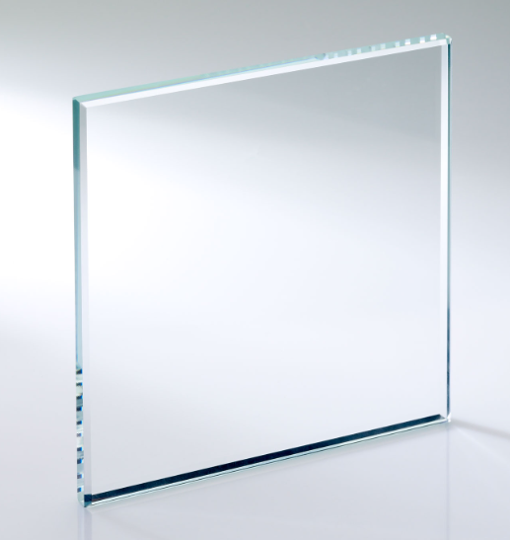
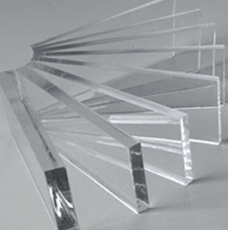
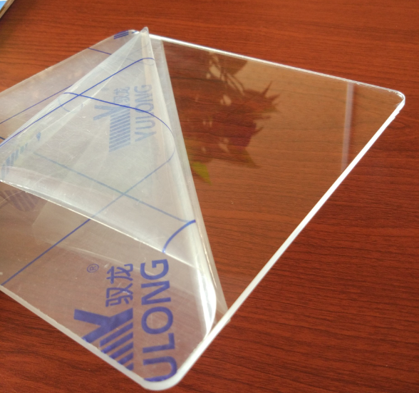
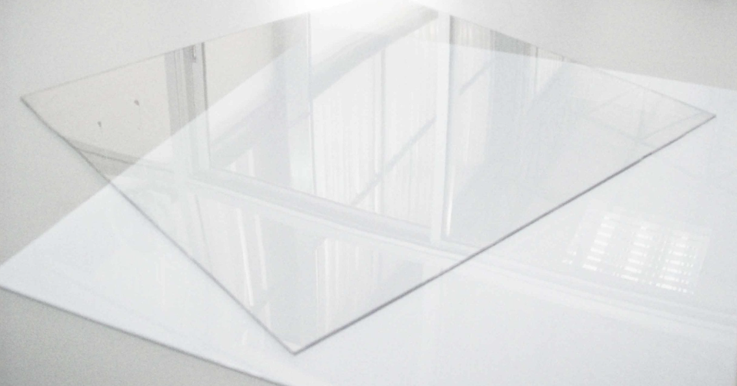
Methodology
Factors for the selection of material for flume:
Strength
Scratch Resistant
Fully Transparent
Budget
Toughened glass
Acrylic Sheet
Plexiglass
Polycarbonate

Slide 7
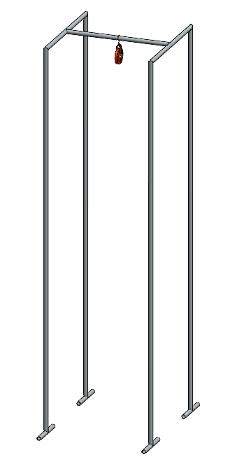
Dimensions of the flume:
Dimensions were taken from the report papers.
Height of flume was adjusted to work on the desired aspect ratios.
Need for Pulley:
Instant removal of gate.
Ease of doing.
Flow should not get disturbed.
1.5 m x 0.7m x 0.4m
Pulley stand

Slide 8
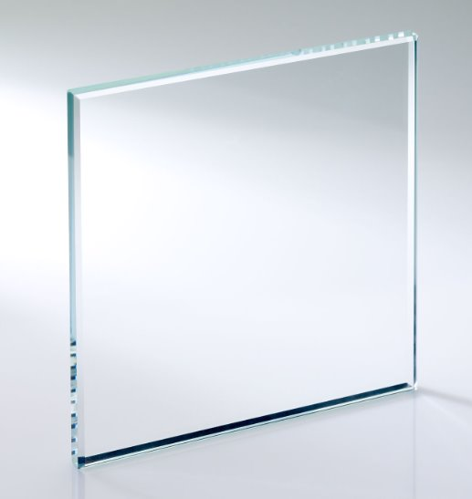
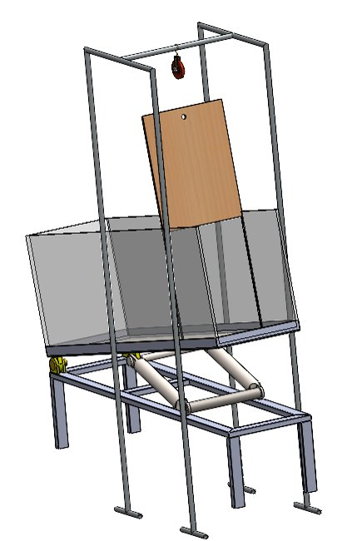
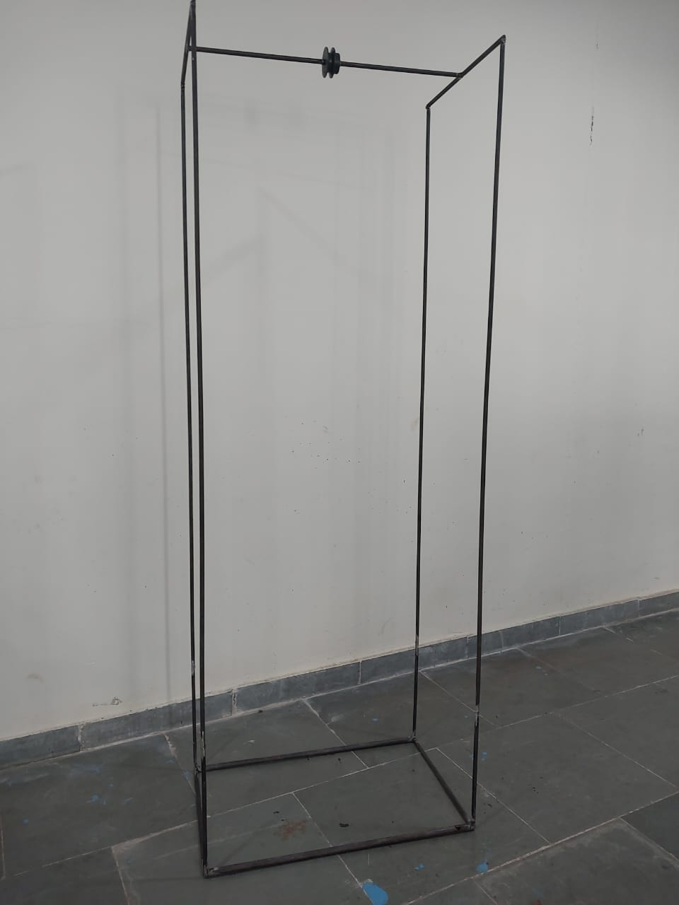
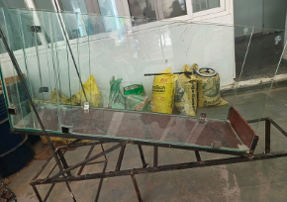
Conclusions of Methodology
Toughened glass is selected
Dimensions = 1.5m x 0.7m x 0.4m
Instead of hand pulling, pulley is used.
Toughened glass
Pulley
Flume setup

Slide 9
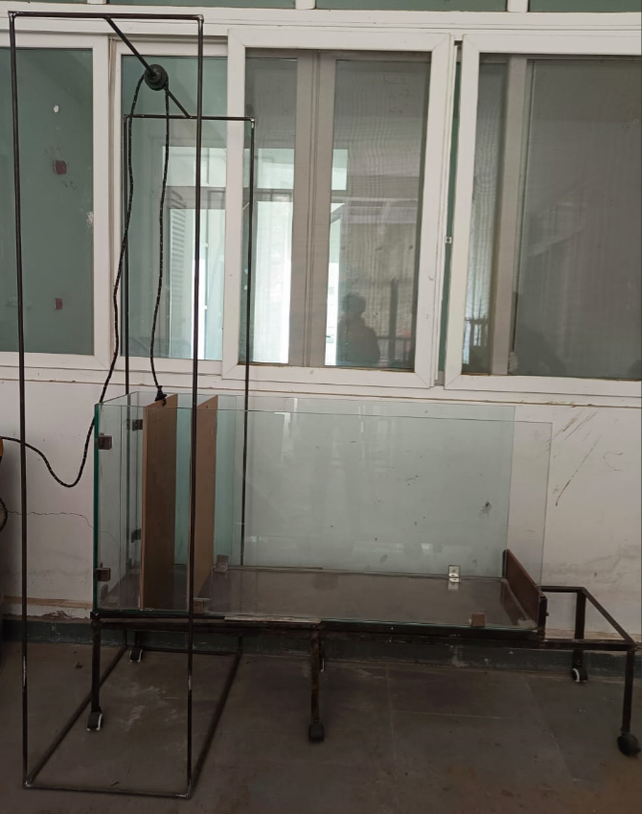
Experimental Setup
Pulley Stand
Flume
The dimensions of flume are 1.5 m x 0.7 m x 0.4 m.
4 different inclinations have been given.
2 gates at 0.15 m and 0.3 m to perform experiment on different volume of flume.
Flume Stand
Gates

Slide 10
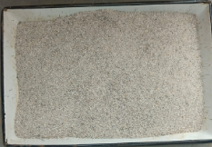
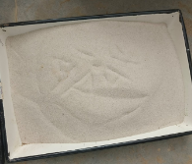
Types of sand
Coarse Sand
Fine Sand
Size: 0.5mm - 1mm
Rough sand
Size:125μm-250μm
Smooth sand

Slide 11
For more precise data sand should be fully compact.​
For that void ratio or void volume is needed.​
Calculations are shown for the same.​
n = Vv/VT
n = 39.7%
n - porosity
Vv - Volume of voids in the Material
VT - Total Volume of Material
e = Vv/Vs
e = 62.5 %
e - void ratio
Vv - Volume of voids in the Material
Vs - Volume of solids in the Material
To Calculate Relative Density,
D = emax - e / emax - emin
D = 57.1%
Where ,
D - Relative Density
emax - maximum possible value of e
emin - minimum possible value of e
e - void ratio

Slide 12

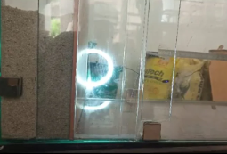
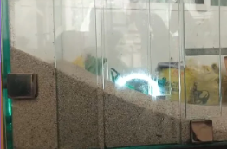
Results
Collection of data
Filling the sand to achieve aspect ratio
Instant removal of gate
Capturing the flow evolution
Fig. Shows Initial Stage
Fig. Shows Final Stage

Slide 13
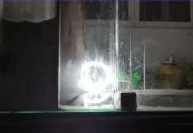
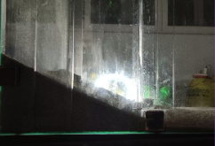
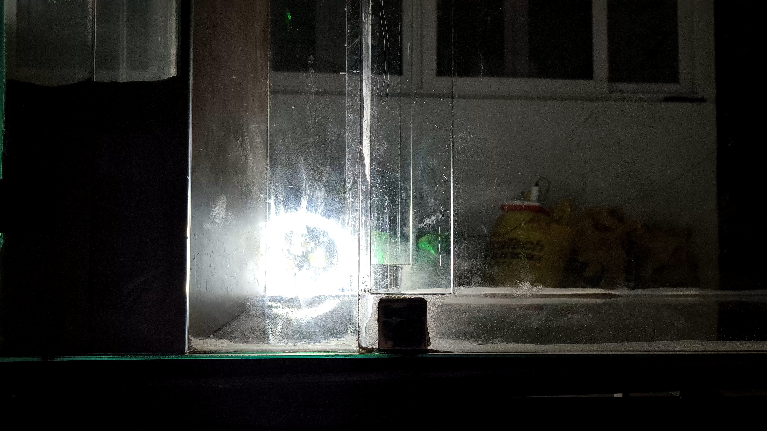

Slide 14
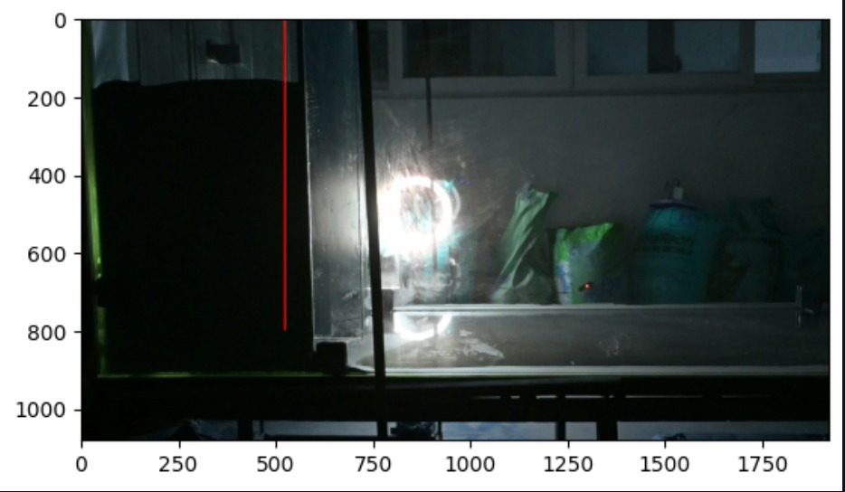
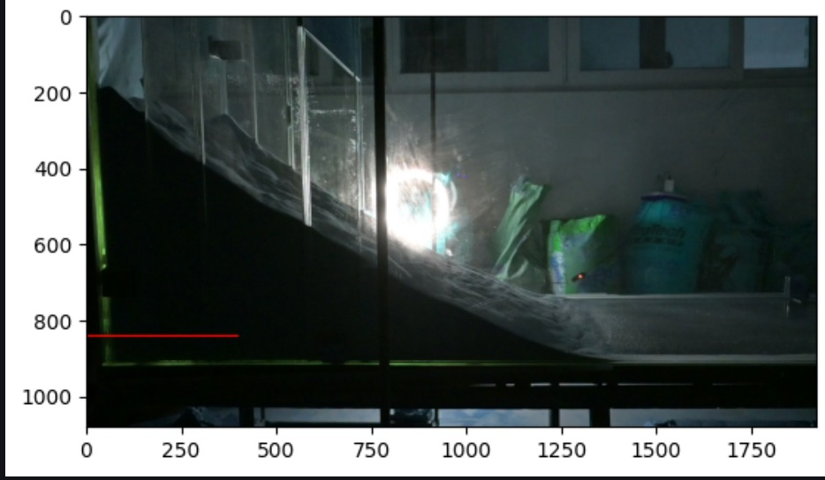
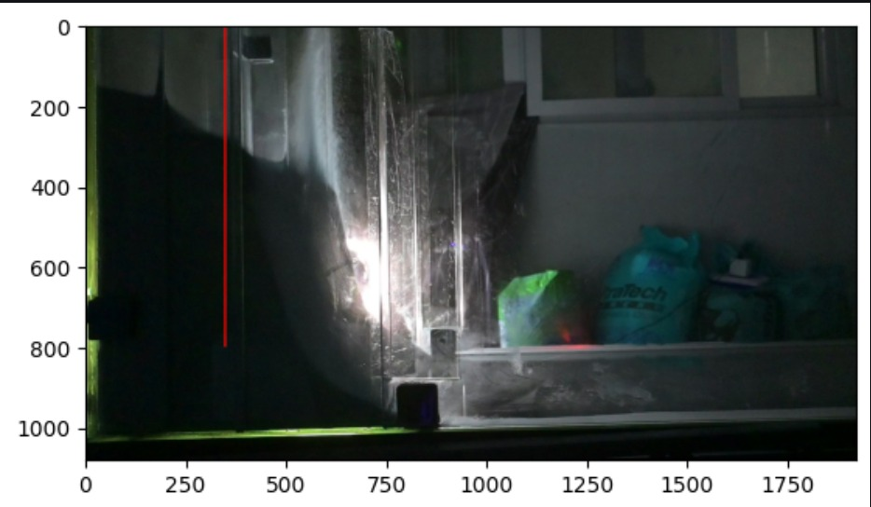
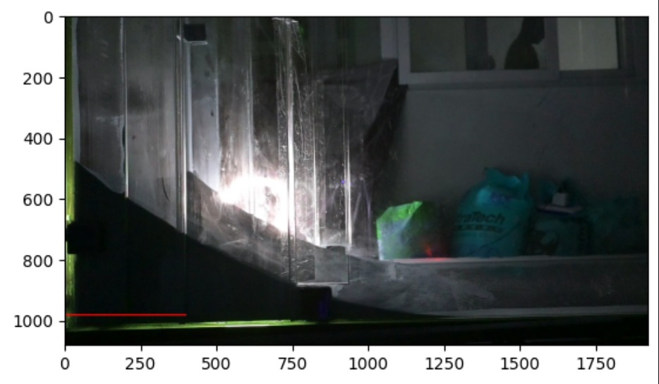
Data Analysis
Horizontal red line for direction of horizontal velocity.
Vertical red line for direction of vertical velocity.
Frames were extracted from input videos and stored in a multidimensional matrix containing RGB values.
Horizontal and vertical velocities were computed across various aspect ratios, gates, and two types of sand.
Fig. Shown for horizontal and vertical velocity for 0.3 m grooving.
Fig. Shown for horizontal and vertical velocity for 0.15 m grooving.

Slide 15
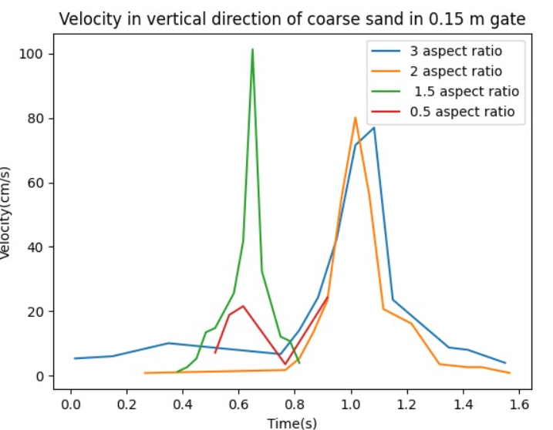
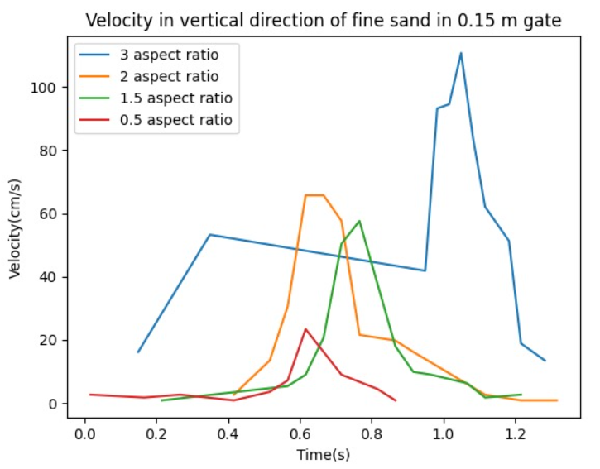
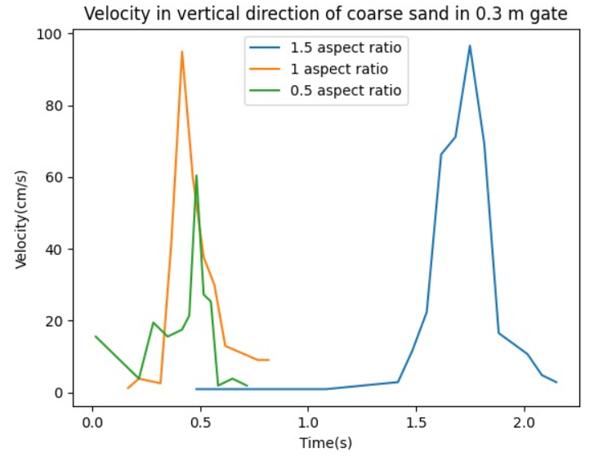
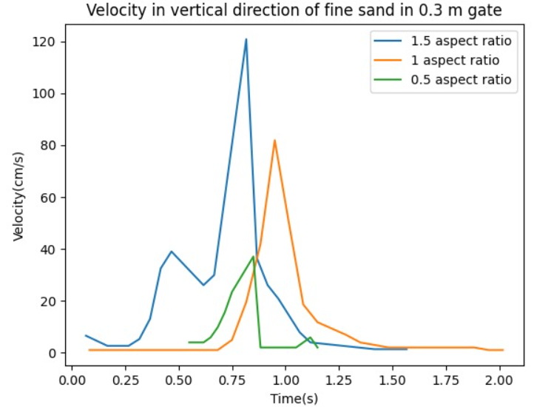
Results for Coarse Sand
Results for Fine Sand

Slide 16
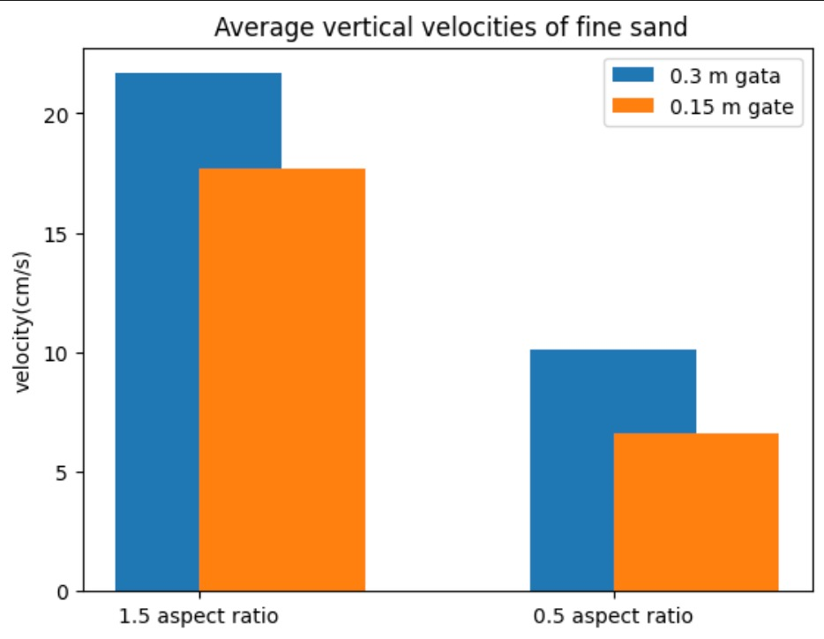
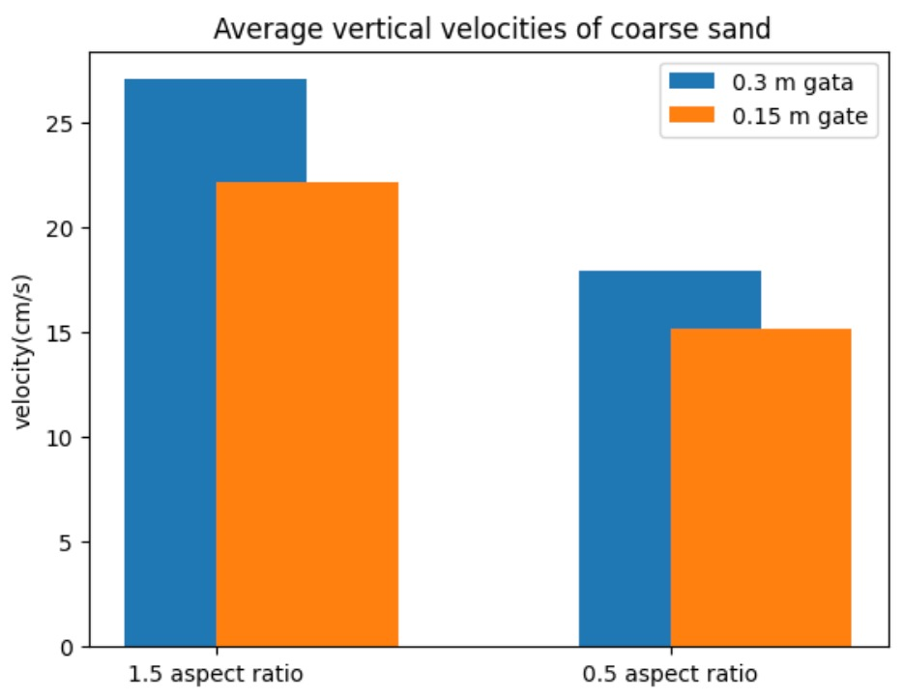
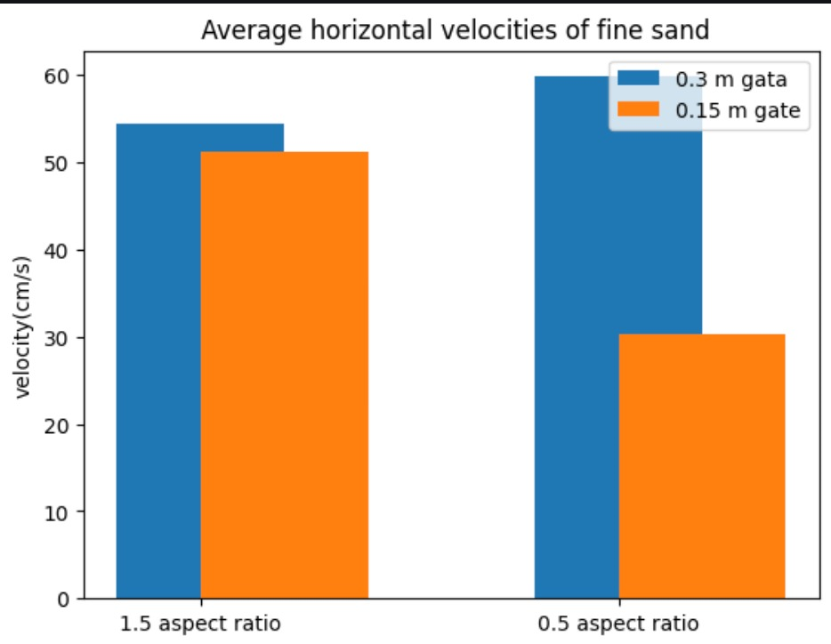
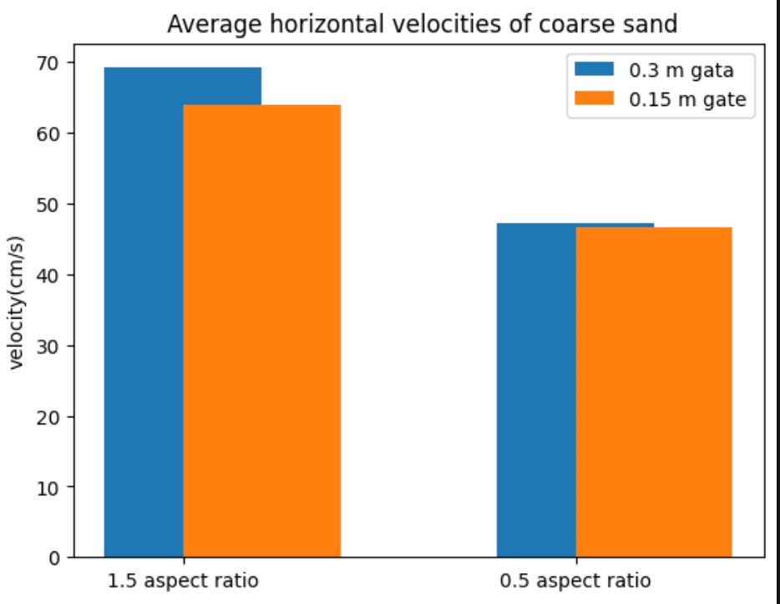
Comparison between Coarse sand and Fine Sand velocities.

Slide 17
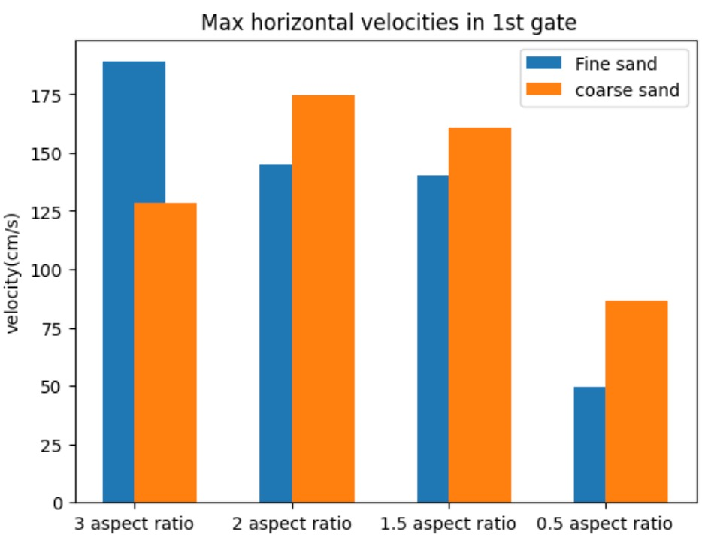
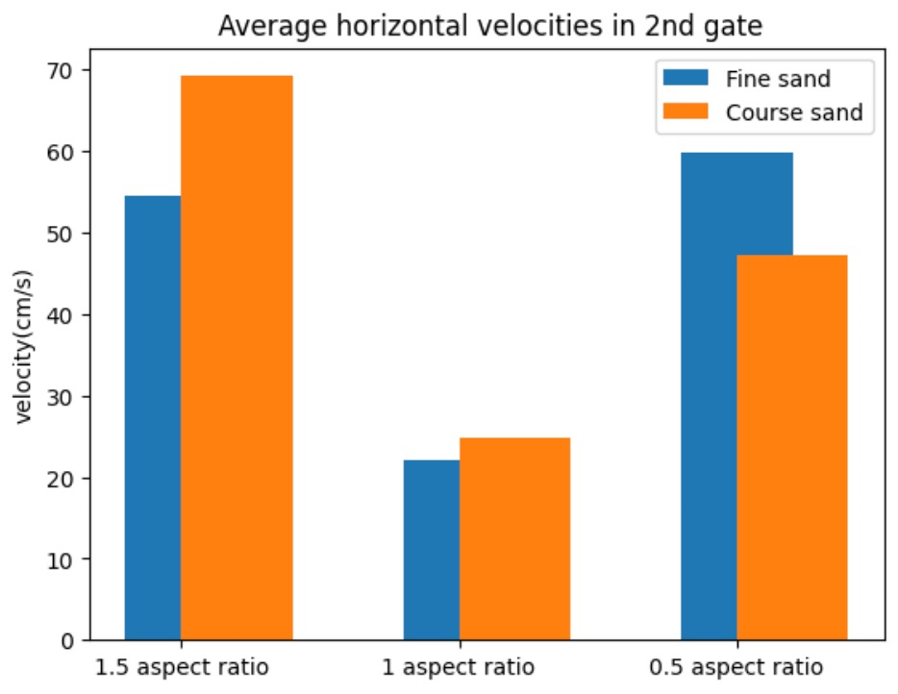
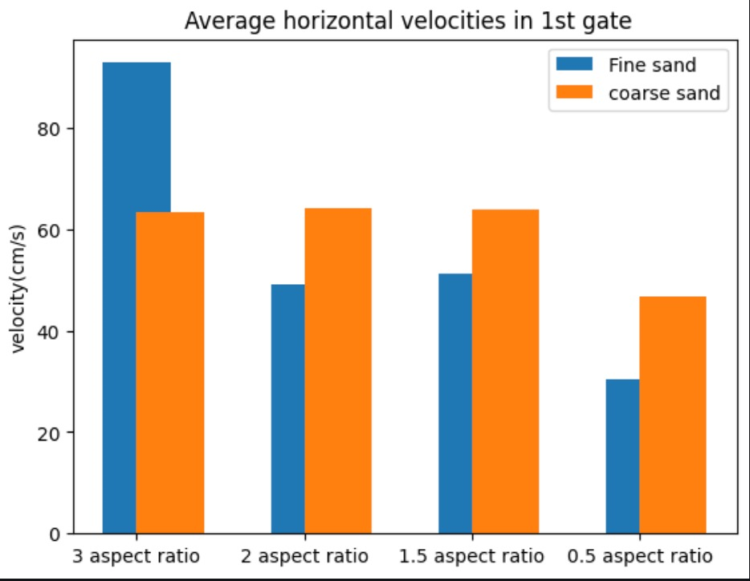
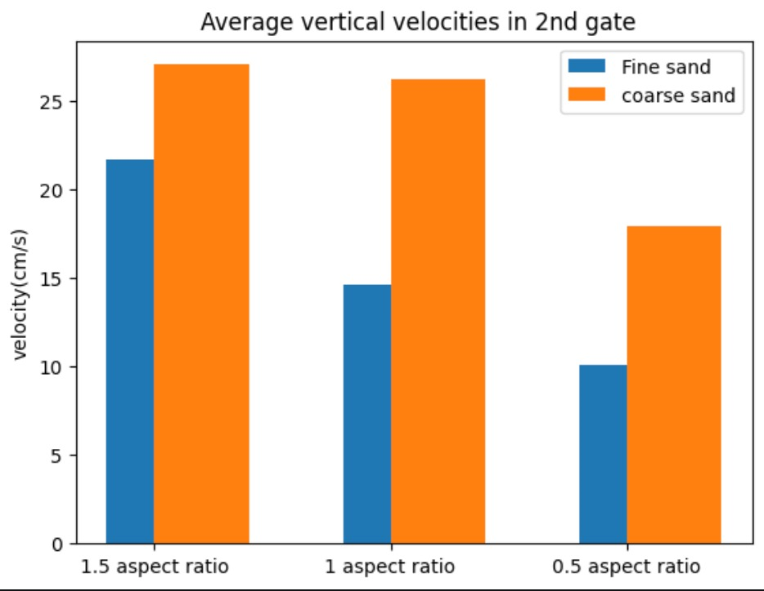
Comparison between velocities for different grooves

Slide 18

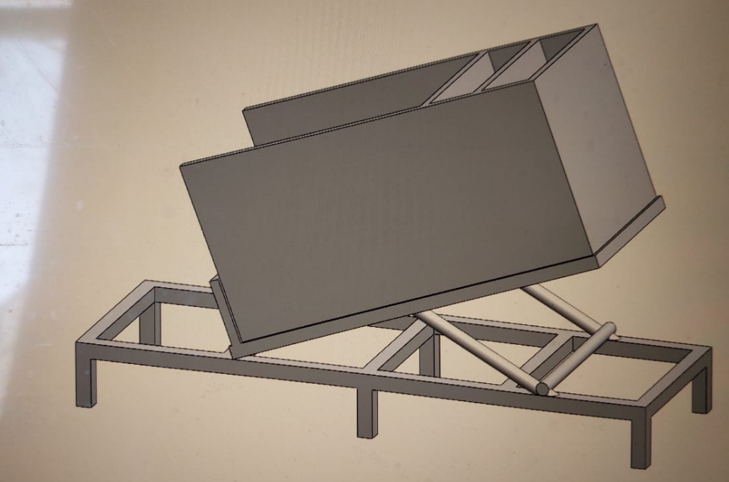
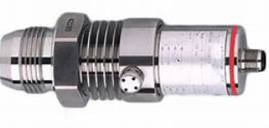
Future Aspects
Different inclinations can be used
Pressure sensors can be used to estimate the impact pressure

Slide 19
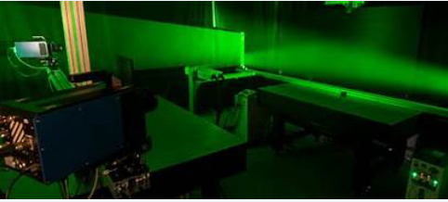
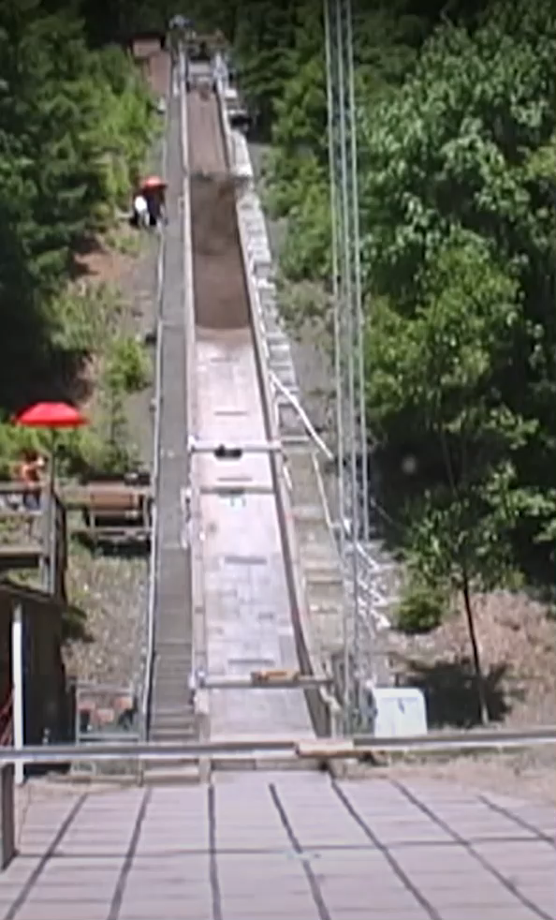
Future Aspects
PIV(particle image velocimetry)
Increasing water content

Slide 20
Conclusion
From the results of the experiment we can conclude that-
Dimensions of flume and positioning of grooves played a major role in analysing granular flow
Higher aspect ratios result in increased velocity.
Vertical and horizontal velocities of fine sand exceed those of coarse sand.
Velocities from the 0.30m gate are generally higher than those from the 0.15m gate.

Slide 21
References
Yung Ming Cheng , Wing Hong Ivan Fung , Liang Li and Na Li, “Laboratory and field tests and distinct element analysis of dry granular flows and segregation processes”
0. HUNGR* and N. R. MORGENSTERN , “Experiments on the flow behavior of granular materials at high velocity in an open channel”
Marcel Hürlimann, Brian W. Mcardell, Christian Rickli, “Field and laboratory analysis of the runout characteristics of hillslope debris flows in Switzerland”

Slide 22
R. Valentino1, G. Barla2, and L. Montrasio1, Experimental Analysis and Micromechanical Modelling of Dry Granular Flow and Impacts in Laboratory Flume Tests.
Liping Yu and Bing Pan, In-plane displacement and strain measurements using a camera phone and digital image correlation
Ivo Baselt, Gustavo Q. de Oliveira, Jan-Thomas Fischer, Shiva P. Pudasaini, “Evolution of stony debris flows in laboratory experiments”
Kun Li , Yufeng Wang, Qiangong Cheng, Qiwen Lin1,Yue Wu and Yanmei Long, “Insight Into Granular Flow Dynamics Relying on Basal Stress Measurements: From Experimental Flume Tests”.

Slide 23
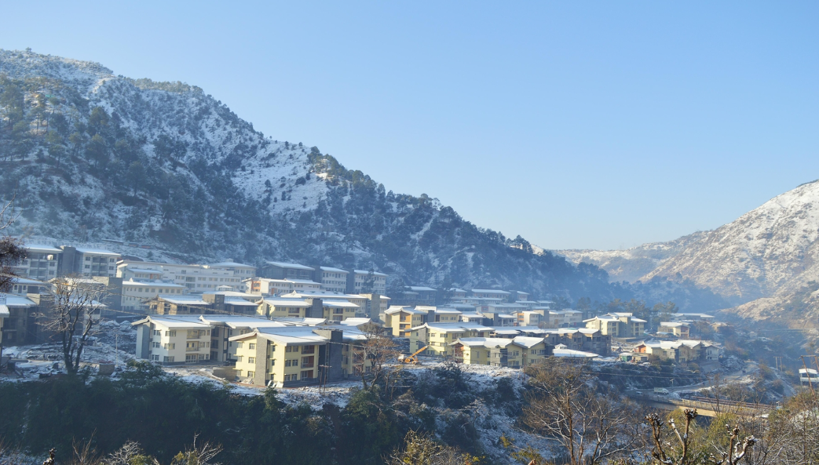
Thank you

